Slide 1
Junior Analityc task
Filips Čalijs

Slide 2
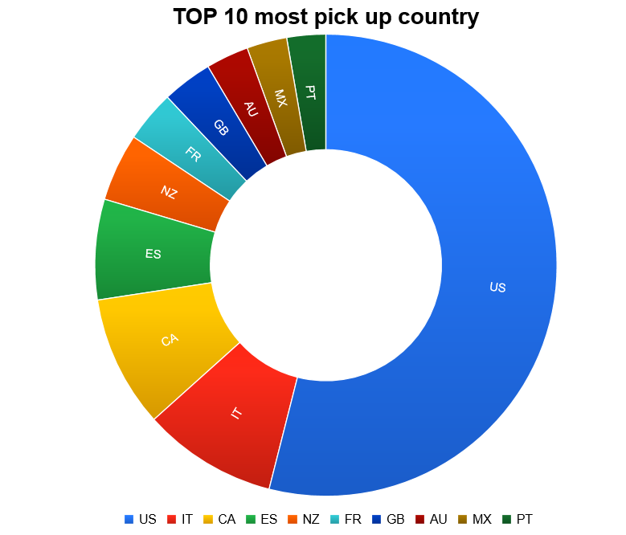
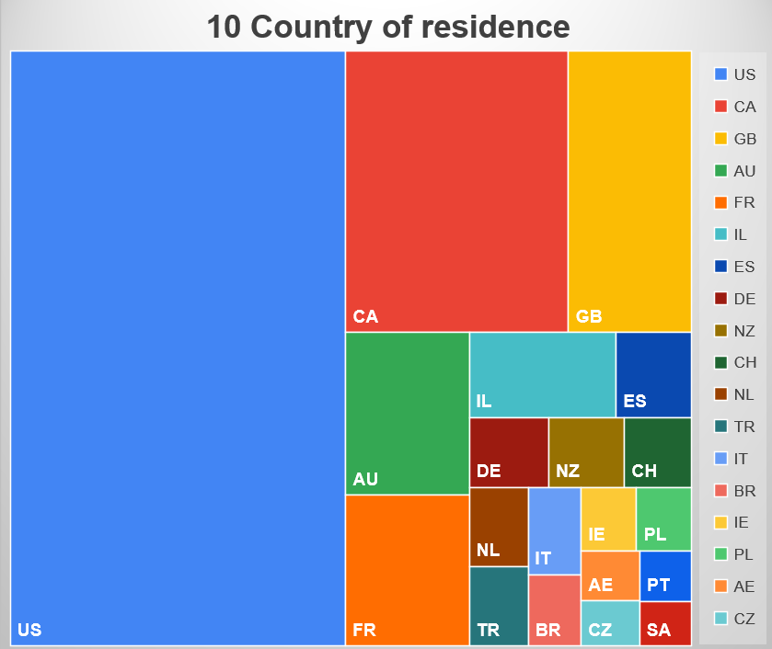
Top countries of residence and their pick up country

Slide 3
Top 20 Countries with total longest duration
Country | Duraction
US | 502
GB | 50
HR | 49
NZ | 70
AU | 43
ES | 124
TH | 35
TR | 61
ZA | 34
IE | 57
EG | 32
CA | 103
CR | 29
IT | 52
ME | 26
PT | 26
NL | 24
RO | 24
GR | 22

Slide 4
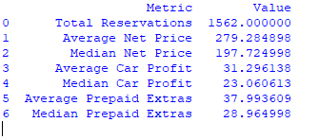
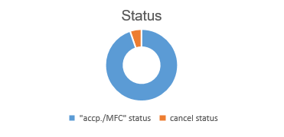
Average and median of datas

Slide 5
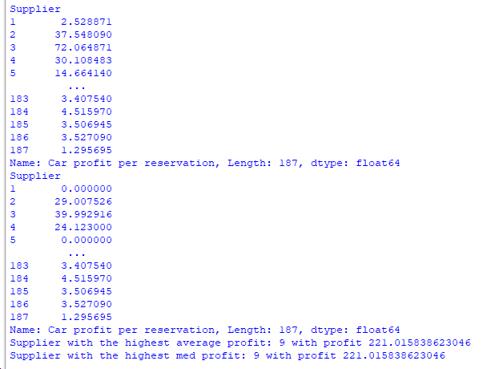
TASK 2) Find out which supplier has impacted the average/median car profit per reservation the most.
There are many ways to find the supplier who had the greatest impact on the average and median profit, but I used only two methods: The second method seems more logical and correct to me: using Python and pandas to find the average and median, which is easy and effective. However, there are some nuances (for example, a supplier who brought in customers only twice but with the highest car per reservation will rank higher, while another supplier who brought in more customers but with a lower amount will rank lower in this scheme).

Slide 6
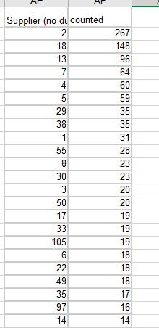
TASK 2) Find out which supplier has impacted the average/median car profit per reservation the most.
It makes sense that the supplier who most frequently appears in the list will have a very large influence on the average and median. Therefore, I copied the sorted list of suppliers with only unique IDs and then used COUNTIF to count each appearance of that supplier. As a result, the supplier who had the most impact appeared is 2 - 267 times, followed by supplier 18 with 148 times, and so on. However, suppliers who appeared in the list only once or less (such as 184, 185, etc.) also had an impact.

Slide 7
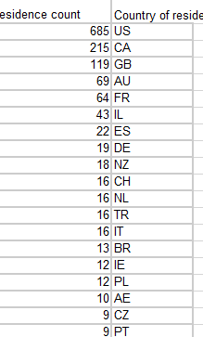
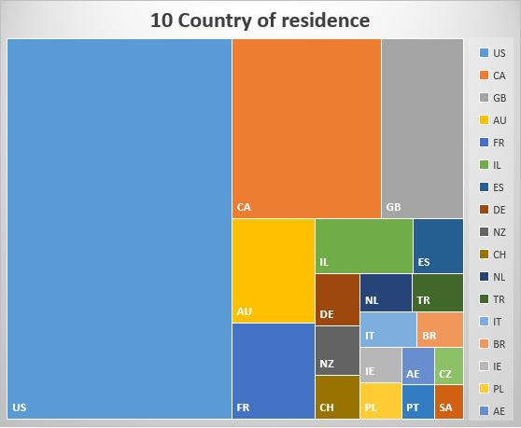
TASK 3) Find out which country of residence has impacted the average or median car profit per reservation the most.
This is similar to task number two, but here I copied the sorted list of countries with only unique IDs and then used COUNTIF to count each appearance of these suppliers. As a result, the country with the most influence was the US, appearing 685 times, followed by CA with 215 times, and so on.

Slide 8
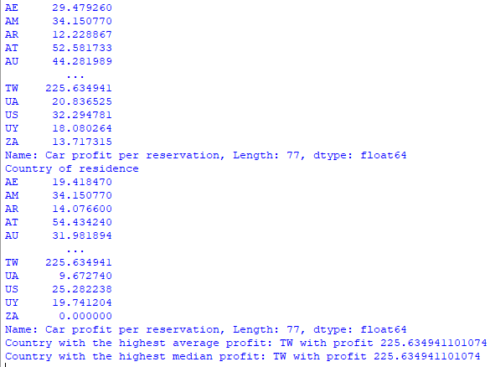
TASK 3) Find out which country of residence has impacted the average or median car profit per reservation the most.
The second method is no different from the second task - using Python and pandas to find the average and median, which is easy and effective.

Slide 9
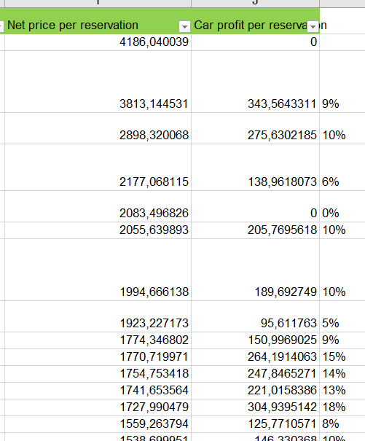
TASK 4) If you have noticed areas for improvement in regards to the net price and car profit ratio, please summarize the necessary improvements and write a short explanation with arguments.
Sorting by net price (descending price or highest profit (argument facilitates search))
Calculate profit percentage from net price (very convenient to understand profit and makes it more simple to understand profit)
Zero profit in certain cases can be attributed to various factors, such as loss of customers due to unsatisfactory service or inadequate quality of cars.

